Slide 1
Simulate the robot in Gazebo
Understand TFs
Design a custom robot with URDF
Simulate the robot in Gazebo

Slide 2
Simulate robot with Gazebo

Slide 3
Installing
First, make sure Gazebo is installed with sudo apt install ros-humble-gazebo* (don't forget the *)
Second, you might need to add this line at the end of your .bashrc (after the line to source ROS 2): source /usr/share/gazebo/setup.bash

Slide 4
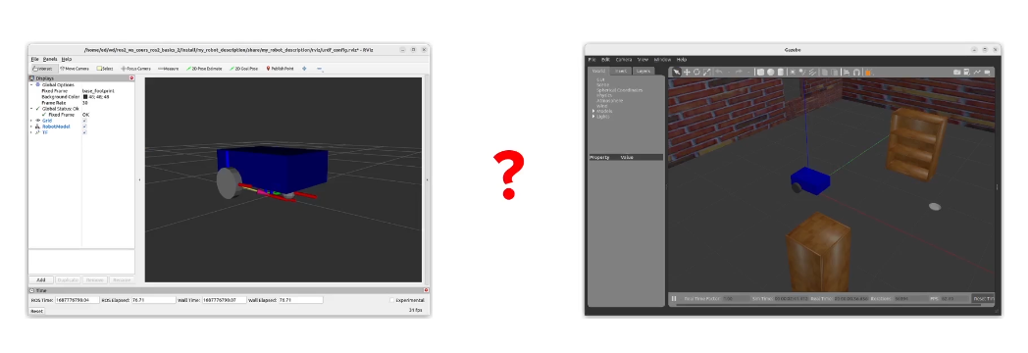
What is difference between RVIZ and GAZEBO?
Visualization, debug (not simulation)
Simulation (gravity, physics)

Slide 5
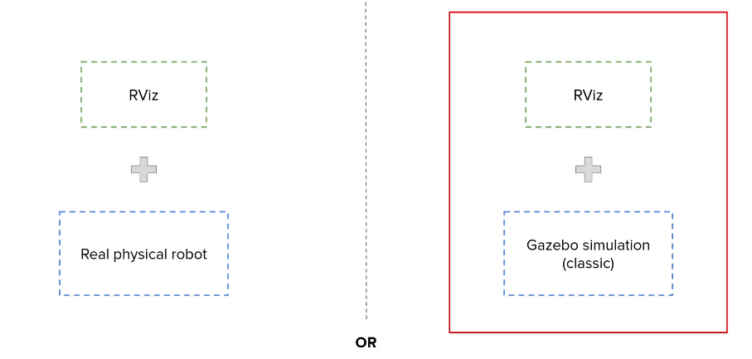
Introduction

Slide 6
Introduction
Understand how gazebo is integrated with ROS2
Adapt URDF for Gazebo
Add a Gazebo control plugin
Create a simulated world for the robot

Slide 7
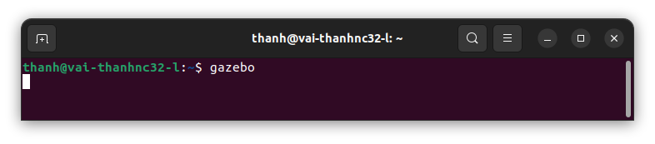
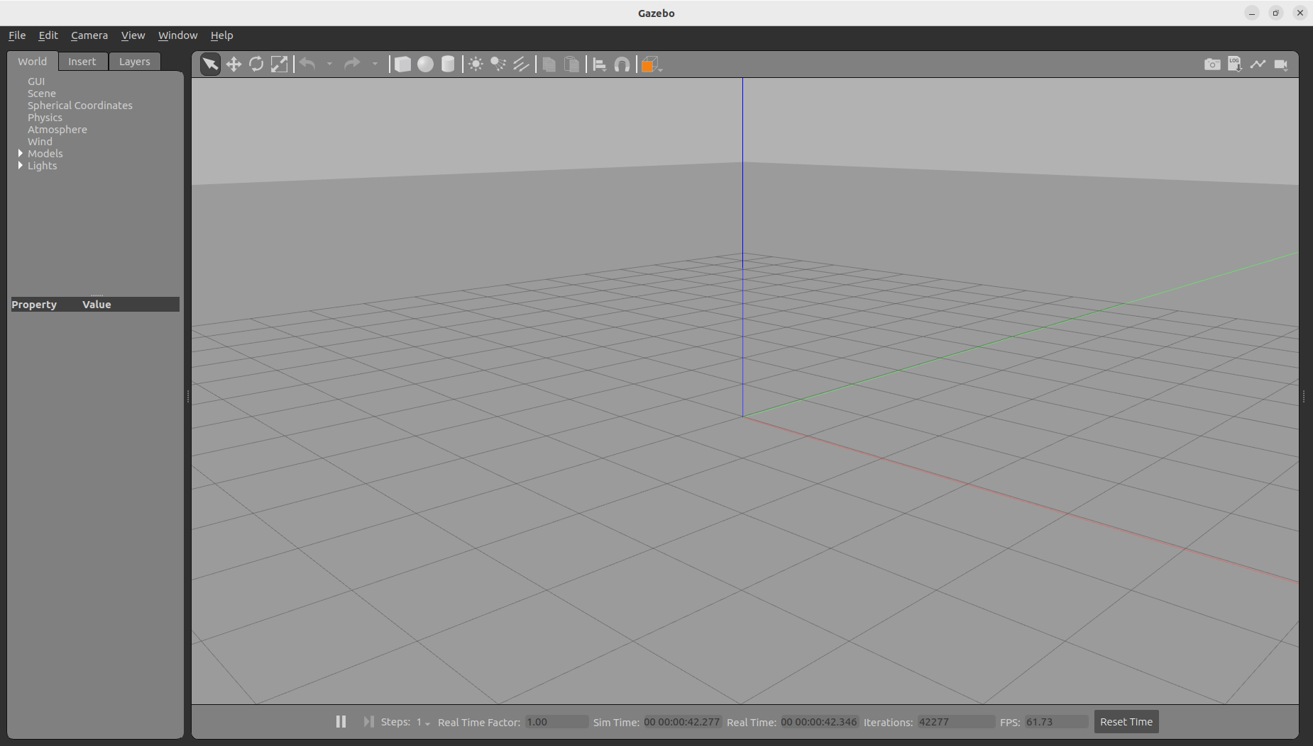
Run Gazebo
in terminal, run gazebo by
And waiting to gazebo start as below, and we can make some simple actions
https://gazebosim.org/docs/latest/tutorials/

Slide 8
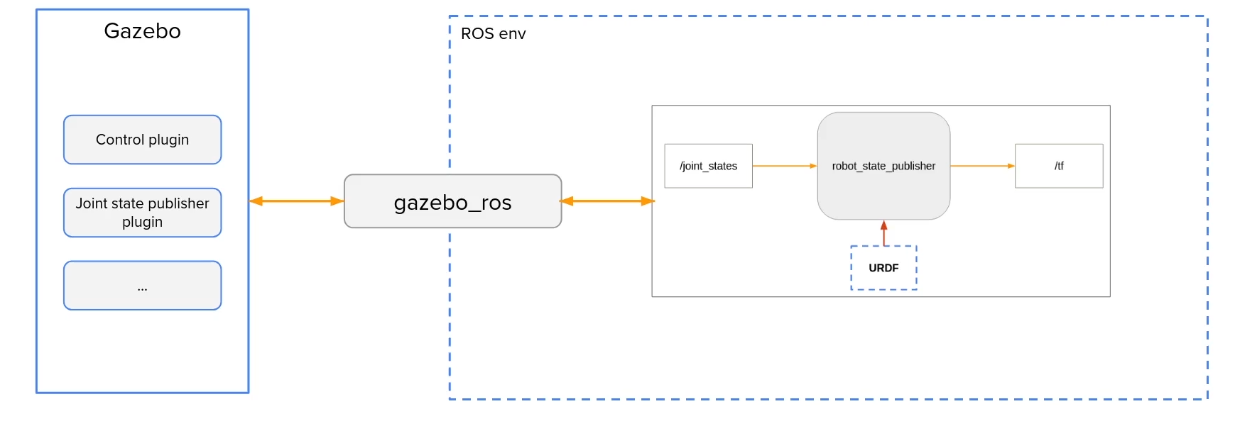
How Gazebo Works with ROS

Slide 9
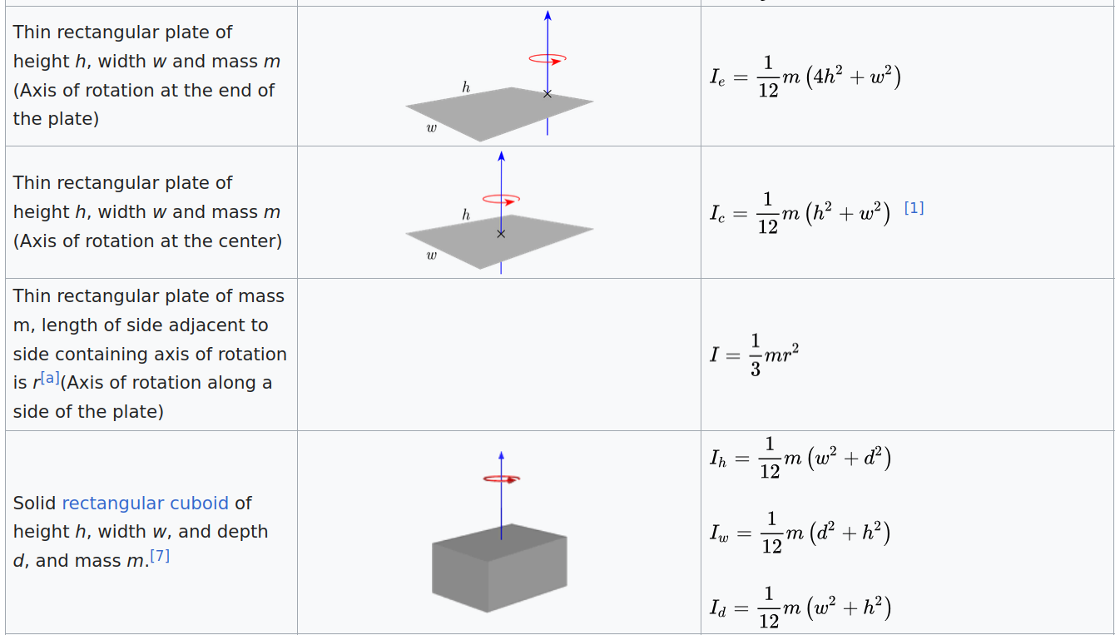
Add Inertia Tags in the URDF
y
z
x

Slide 10
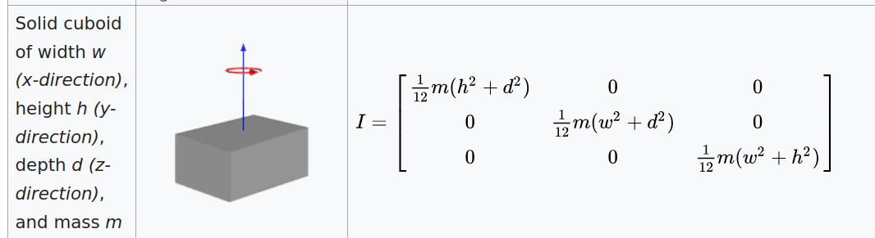
Add Inertia Tags in the URDF
Example for base_link
Inertia of solid box
https://en.wikipedia.org/wiki/List_of_moments_of_inertia#List_of_3D_inertia_tensors
y
z
x

Slide 11
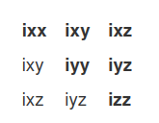
Add Inertia Tags in the URDF
The 3x3 rotational inertia matrix
https://wiki.ros.org/urdf/Tutorials/Adding%20Physical%20and%20Collision%20Properties%20to%20a%20URDF%20Model

Slide 12
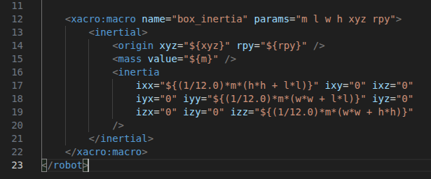
Add Inertia Tags in the URDF
Configure the inertia of body box in common_properties.xacro

Slide 13
Add Inertia Tags in the URDF
Applying inertia for all links as sample sources

Slide 14
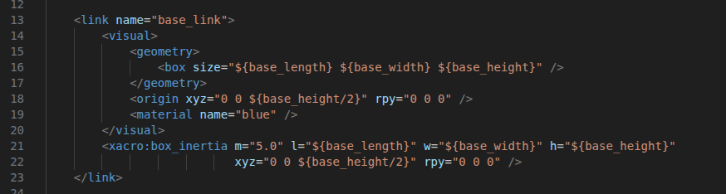
Add Inertia Tags in the URDF
Update inertia for base_link in mobile_base.xacro
unit: kg, m

Slide 15
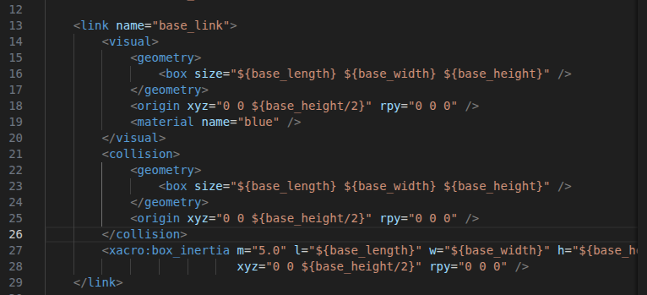
Add Collision Tags in the URDF
Add Collision for base_link in mobile_base.xacro
After </visual>, before xacro:box_inertia

Slide 16
Add Collision Tags in the URDF
Applying Collision for all links as sample sources

Slide 17
Spawn the Robot in Gazebo
Applying Collision for all links as sample sources

Slide 18
Improve URDF with Xacro

Slide 19
Introduction
Properties (variables)
Macros (functions)
Include URDF file inside onather URDF
-> MAke the URDF cleaner, more dynamic, modular, scalable

